Slide 1
Web apps that sign in users & call APIs

Slide 2

Overview
Single Page Apps (SPAs)
Web Apps that call APIs
OAuth 2.0 implicit grant flow
Azure AD app registration
MSAL & code configuration
Sign-in & obtain access token
Call APIs
Daemon / Service Apps

Slide 3
Web apps that sign-in users & call APIs
Notes:
In this first section we’ll look at Web apps that sign-in users & call APIs

Slide 4
Web apps that sign-in users & call APIs
Adding authentication enables a web app access to limited profile details
Name, email, unique ID
Users authenticate in a browser
Web app redirects users to Azure AD to sign-in
Azure AD redirects users back to web app with claims about the user in a security token
Web app can also obtain an access token from Azure AD to act on their behalf
Notes:
Adding authentication enables your web app to access limited profile information, and customize the experience offered to users. Web apps authenticate a user in a web browser. In this scenario, the web application directs the user to sign in to Azure AD. Azure AD returns a sign-in response through the user’s browser, which contains claims about the user in a security token.
Signed-in users use the Open ID Connect standard protocol itself simplified by the use of middleware libraries.
As a second phase you can also enable your application to call Web APIs on behalf of the signed-in user.

Slide 5
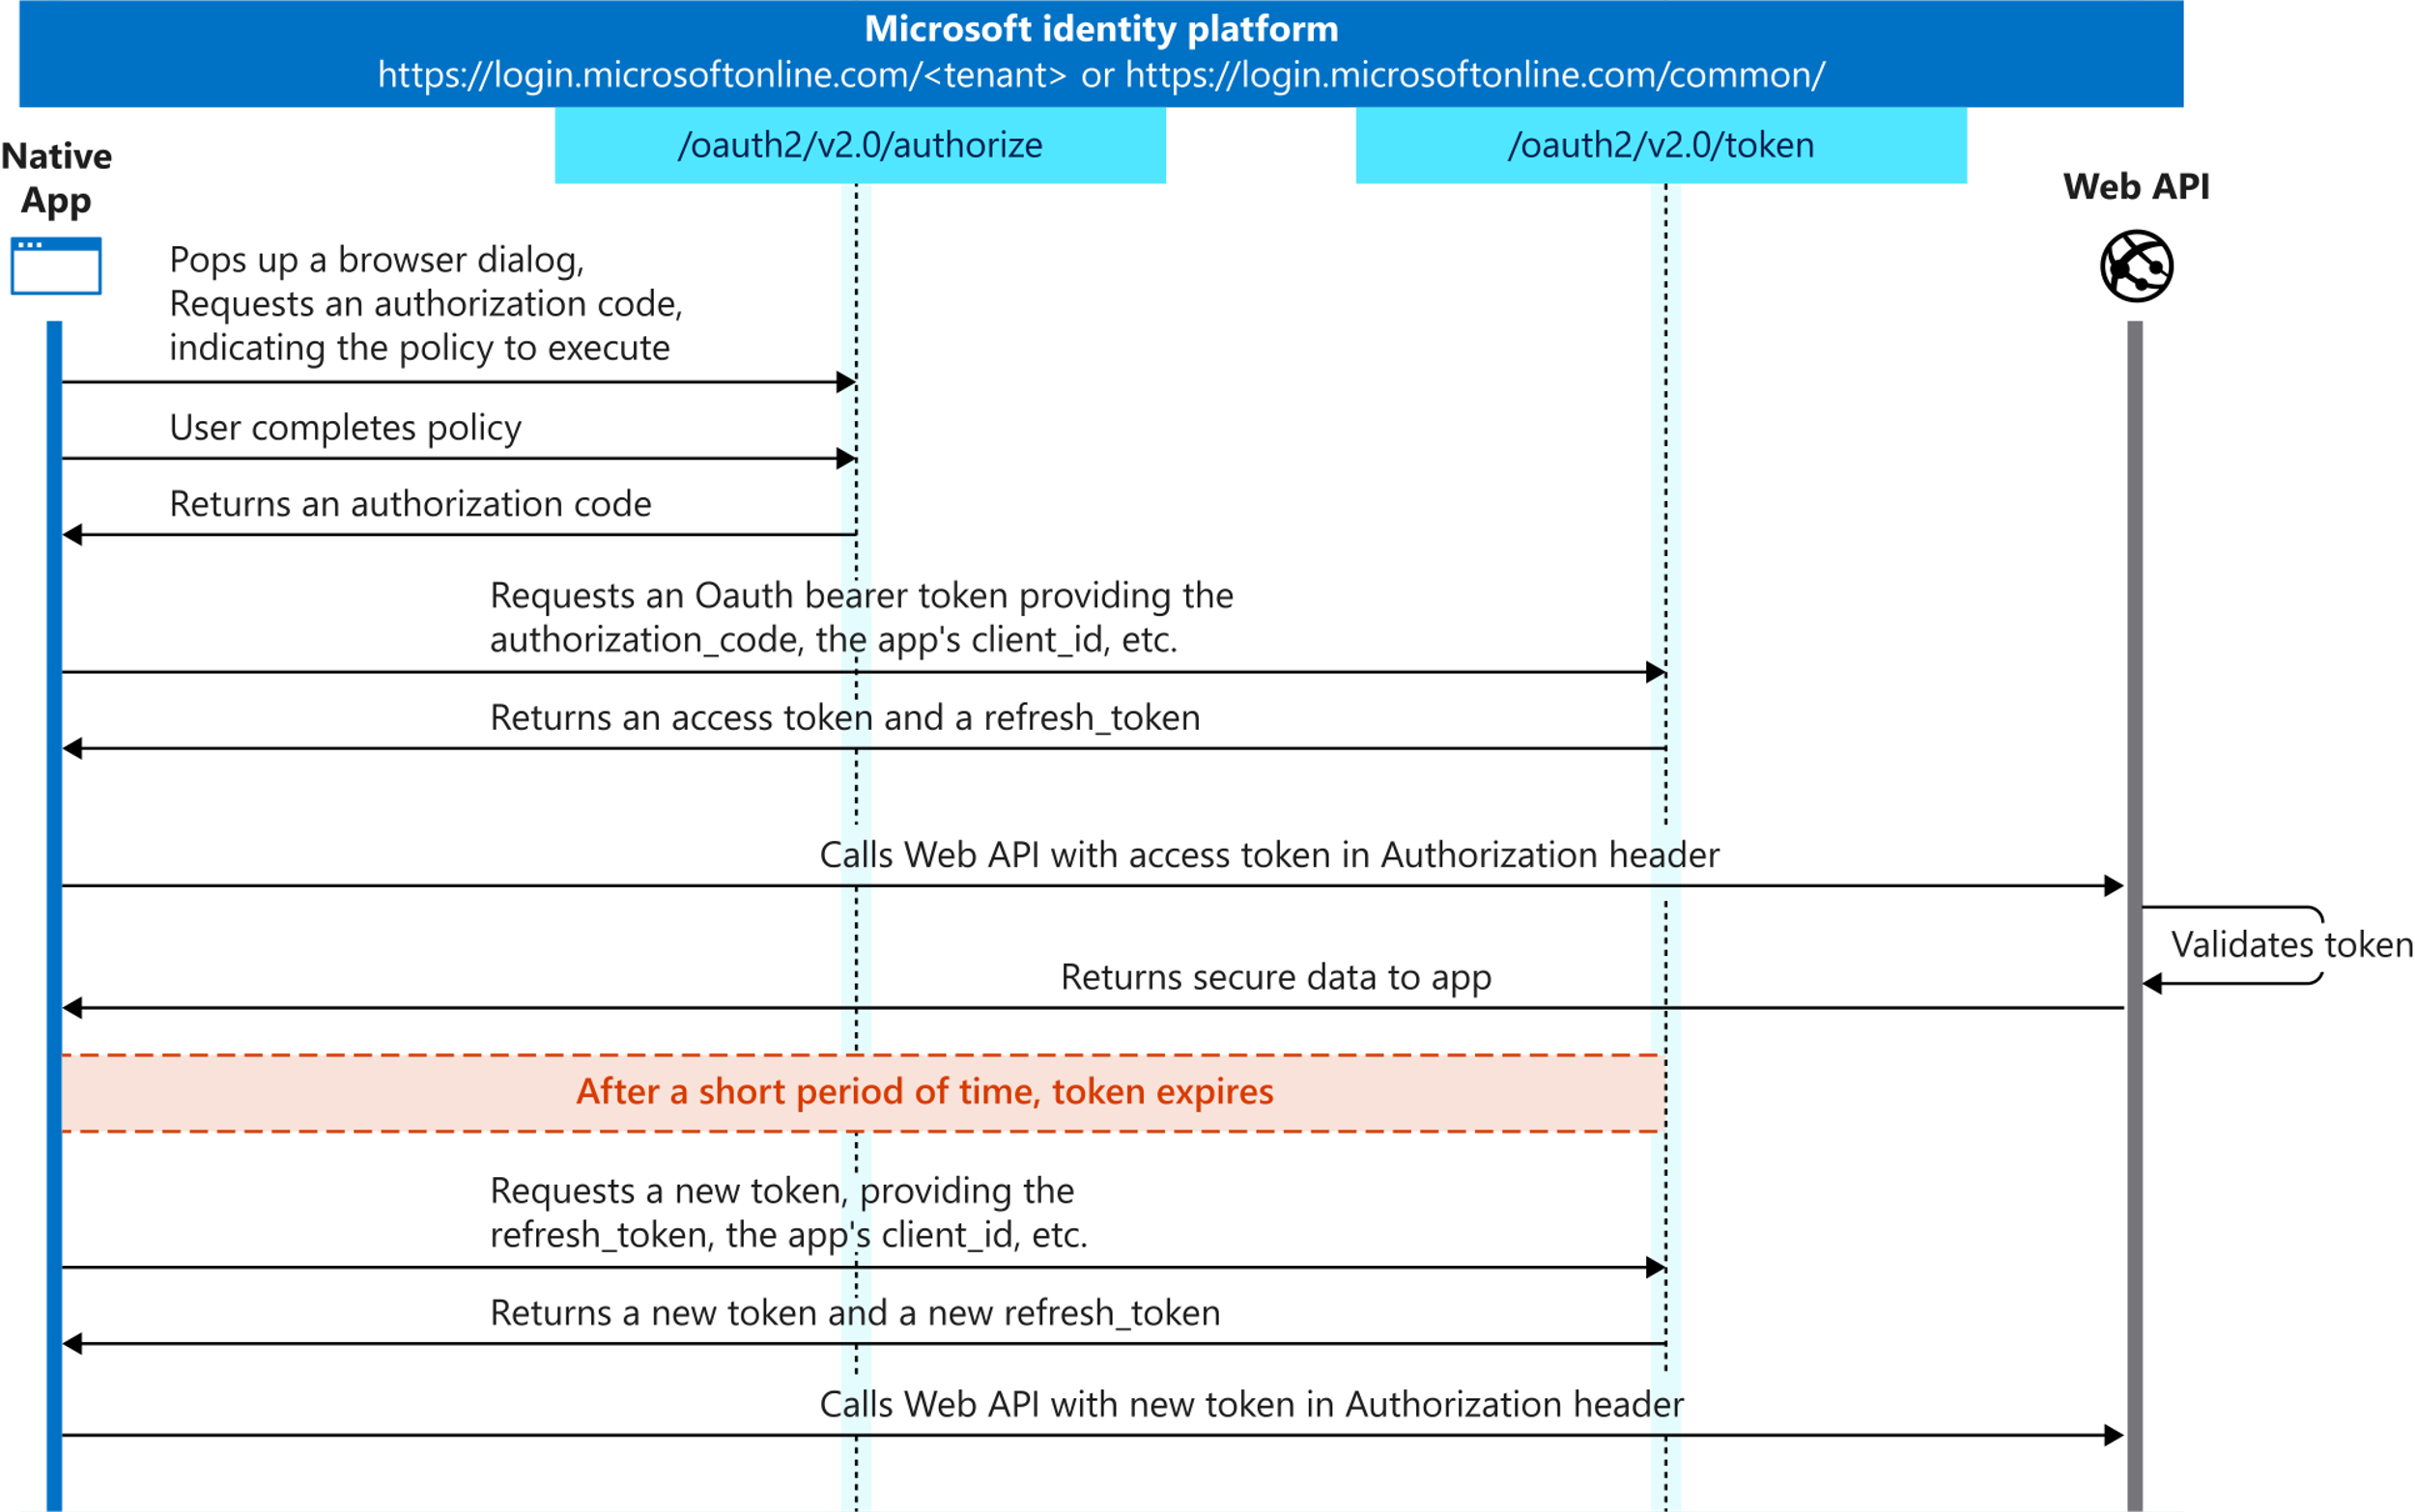
OAuth 2.0 authorization code grant flow
Notes:
<explain the process & steps for the auth code flow… don’t go into details, just high-level how it works>

Slide 6
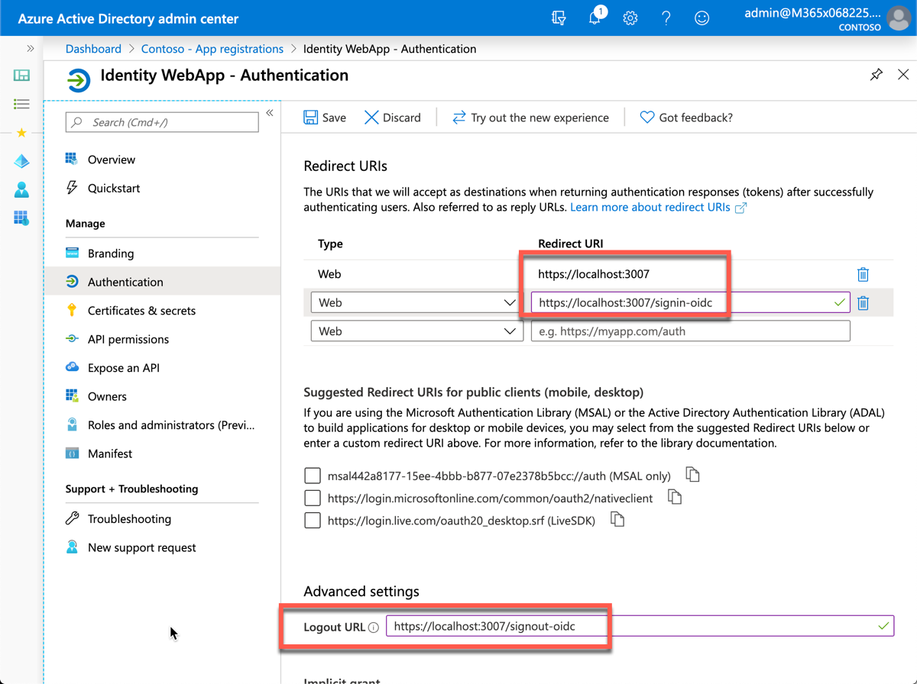
Azure AD app registration
Web apps must have an associated Azure AD app registration to support user sign-in & obtain access token
Ensure Redirect URI & Logout URL are set
Web app also needs a client secret
Used by app to authenticate when exchanging auth code for access token
After creating app, copy 3 values for use in MSAL & code configuration:
Tenant ID
Client ID
Client secret
Notes:
When registering the app in Azure AD, ensure the redirect URI of the app points to the callback URL of the web app. This URL must match the redirect URL provided by the SPA when the authentication process is started. The authorization code will be sent to this endpoint, which means you need to configure any authentication libraries and/or middleware to listen on this endpoint to receive the authorization code.
A sign-out URL should also be specified so the authentication libraries and/or middleware deletes any cached tokens or other data that are only needed for signed in users.
The web app will also need a client secret to sign in with Azure AD to exchange the authorization code for an access token.
There are three things you'll need from the Azure AD app registration:
**tenant ID**: ID of your Azure AD directory
**client ID**: unique auto-generated ID of the app (*this is also referred to as the application ID*)
**client secret**: secret you created during app registration

Slide 7
MSAL .NET Configuration
Configure any middleware and libraries that handle authentication within the application startup
In ASP.NET Core, this is done in the Startup.cs file, specifically the ConfigureServices() method
Configure the Open ID connect middleware to process the ID token:
Set the authority for Azure AD to the Oauth 2.0 Azure AD endpoint for the tenant where the Azure AD app was registered
Request an authorization code & ID token when the user signs in
Associate the user’s name property in ASP.NET to the claim preferred_username returned in the ID token
Notes:
The web app startup process needs to be modified to configure the support for signing-in with Azure AD and obtaining an ID token.
In an ASP.NET Core web application, add the following to the `ConfigureServices()` method. Here you need to add code to the `ConfigureServices()` method. This code will complete the Azure AD configuration by doing the following steps:
set the authority for Azure AD to be the OAuth 2.0 Azure AD endpoint
request both an authorization code and ID token when the user signs in
associate the user's name property in ASP.NET to the **preferred_username** claim returned in the ID token
create a callback when the authorization code is received to add all claims from the ID token to the current signed-in user's claims

Slide 8
User Sign-in & acquiring an access token
Sign-in process handled by redirecting user to Azure AD sign-in page
The MSAL .NET SDK uses the appsettings.json to create the sign-in request
Upon successful sign-in, user is redirected back to the web app that can then request an access token
var application = ConfidentialClientApplicationBuilder.Create(appSettings.ClientId)
.WithAuthority(appSettings.Instance + appSettings.TenantId +"/v2.0/")
.WithRedirectUri("https://localhost:5001" + appSettings.CallbackPath)
.WithClientSecret(appSettings.ClientSecret)
.Build();
var accessToken = await application.AcquireTokenSilent(scopes, account).ExecuteAsync();
Notes:
The sign-in process is handled by redirecting the user to the Azure AD sign-in page. This is set by default for you when you create a new ASP.NET Core web application.
The sign-in process uses the values from the **appsettings.json** file and the configuration defined in the previous setup to create the Azure AD URL to send the user to. This URL specifies things like the Azure AD application's ID, the tenant ID, and the scopes required by the web application.
When a user signs-in to Azure AD and is redirected back to the web application, the web app can use the MSAL.NET library to obtain an access token
The account is retrieved from the currently signed-in user. The token can then be used to call a secured endpoint.

Slide 9
Calling APIs – Microsoft Graph
Last part of the process is to submit a request to the authenticated endpoint with the access token
When working with ASP.NET, it’s preferred to create an instance of the authenticated client in Startup.cs
Add it as a singleton to ASP.NET’s dependency injection
public UserController(GraphServiceClient graphServiceClient) {
_graphServiceClient = graphServiceClient;
}
public async Task<IActionResult> Index() {
var userRequest = this._graphServiceClient.Me.Request()
var userResponse = await this._graphServiceClient.SendAsync(request);
return View(userResponse)
}
Notes:
The last part of the process is to use the access code in a request to a secured endpoint.
One way to do this is to create an instance of the Microsoft Graph client and add it as a singleton to ASP.NET Core's dependency injection system:
The instance of the service can then be used from a controller within the web application

Slide 10
Proof Key for Code Exchange (PKCE)
Confidential clients that leverage the auth code flow can keep the secret hidden from users of the app
Public clients that leverage auth code flow require the secret be distributed with the app or dynamically requested
Desktop / console / mobile apps
Daemon apps / services
Introduces the possibility of compromising the secret under specific scenarios
PKCE is a mitigation technique to protect against this threat for public clients using auth code flow
https://tools.ietf.org/html/rfc7636
Microsoft identity supports PKCE
Notes:
This unit has addressed using a confidential client with the authorization code grant flow. Confidential clients are those applications that are capable of keeping a client secret hidden from the users of the app, as is the case with a web application.
With distributed consoles, desktop or mobile apps, the client secret must be distributed with the application or the application must request it. In either case, the secret is obtained by a device outside of the control of the application owner. These types of applications are referred to as public clients.
Microsoft identity provides support for the Proof Key for Code Exchange (PKCE) which is a mitigation technique to protect against a specific threat for public clients utilizing the authorization code grant.
PKCE addresses the scenario where public clients that use the authorization code flow are susceptible to an authorization code interception attack. The details of this scenario are outlined in the following RFC by the IETF: [Proof Key for Code Exchange by OAuth Public Clients](https://tools.ietf.org/html/rfc7636)
While there is a long list of pre-conditions, the described attack has been observed in the wild and has to be considered in OAuth 2.0 deployments. While the OAuth 2.0 threat model in the RFC describes mitigation techniques, they're not applicable since they rely on a per-client instance secret or a per-client instance redirect URI.
To mitigate this attack, applications utilize a dynamically created cryptographically random key called "code verifier". A unique code verifier is created for every authorization request, and its transformed value, called "code challenge", is sent to the authorization server to obtain the authorization code. The authorization code obtained is then sent to the token endpoint with the "code verifier", and the server compares it with the previously received request code so that it can perform the proof of possession of the "code verifier" by the client. This works as the mitigation since the attacker would not know this one-time key, since it is sent over TLS and can't be intercepted.
Microsoft identity provides support for the Proof Key for Code Exchange (PKCE) which is a mitigation technique to protect against a specific threat for public clients utilizing the authorization code grant.

Slide 11
Demo

Slide 12
Thank you.

